Slide 1
Codecademy Machine Learning Fundamentals Capstone Project: Date-a-Scientist
Duane Tanaka

Slide 2
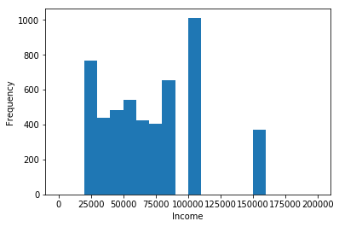
Exploration of Data Set
Histogram of income distribution

Slide 3
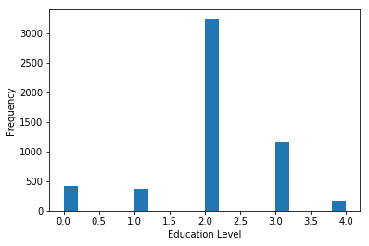
Exploration of Data Set
Histogram of education distribution (0: high school, 1: two year college, 2: four year college, 3: master’s degree, 4: PhD program)

Slide 4
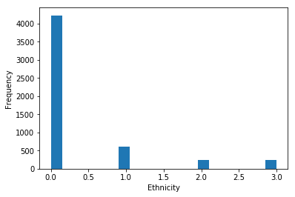
Exploration of Data Set
Histogram of ethnicity distribution. (0: white, 1: Asian, 2: black, 3: Hispanic / Latino)

Slide 5
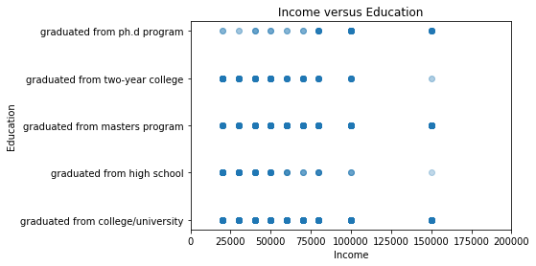
Exploration of Data Set

Slide 6
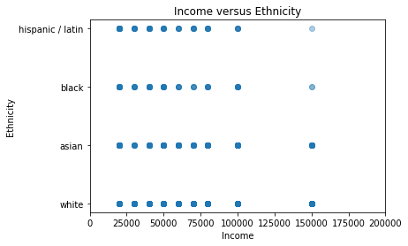
Exploration of Data Set

Slide 7
Statement of Questions
Given income, education, and length of essays, can we predict ethnicity? I was interested in how education, which might reflect length of essay, as well as socio-economic class may be related to ethnicity, as well as how this information is reflected in a dating site like OK Cupid. I used Linear Regression and K-Nearest Neighbors Regression and compared the two.

Slide 8
Statement of Questions
2. Given ethnicity, education, and income, can we classify whether the word “passionate” appears in the essays? I am curious how demographics affect the use of certain verbiage to express romance. For this study, I utilized the K-Nearest Neighbors algorithm for classification. Support Vector Machines were then used to classify the same data as a comparison.

Slide 9
Explanation of New Columns
I modified and added new columns in the following order:
After exploring the dataset, I noticed that a lot of the values for “income” were “-1.” I didn’t know what this meant and this value would affect my analysis, so I eliminated them from the DataFrame. In addition, with ethnicities, there were many different kinds of values that included mixed ethnicities that would complicate the analysis so I just included “white,” “Hispanic / Latino,” “black,” and “Asian.” Finally, I narrowed down education to those that graduated from high school, two year college, university, master’s program, and Ph.D program. Finally, I reset the indices.

Slide 10
Explanation of New Columns
2. I created two new columns for essay length and the occurrence of the word “passionate” in the essay. I removed the NaNs from the essays and proceeded to create a column for the length of essay0 to essay9 combined, as well as determine a Boolean value for the occurrence of the word “passionate” in the essays.
3. I mapped both the “ethnicity” and “education” columns which have string values to numbers to separate the values in a fashion that would facilitate the analysis and learning processes. I created two new columns accordingly, “ethnicity_code” and “education_code.”

Slide 11
Explanation of New Columns
4. I created a new DataFrame called “feature_data” with the columns from “df” which included: “income,” “ethnicity_code,” “education_code,” “essay_len,” and “essay_includes_passionate.” I then used Min-Max Normalization for the data in “feature_data.” Finally, I dropped any remaining NaN’s from the DataFrame.

Slide 12
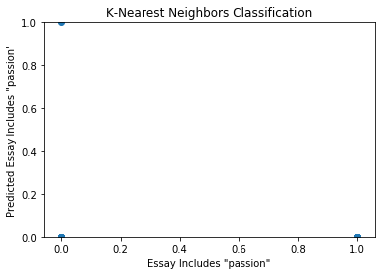
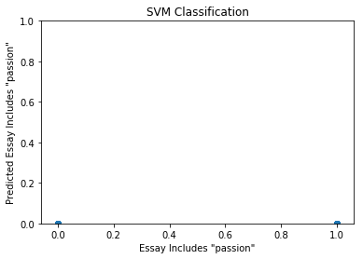
Comparison Between Two Classification Approaches
For classification, I used the K-Nearest Neighbors and SVM algorithms to predict whether the essays included the word “passionate” based on ethnicity, education, and income. The following are respective scatter plots for actual versus prediction:

Slide 13
Comparison Between Two Classification Approaches
Compared to K-Nearest Neighbors, with SVM, after a hyperplane is determined, points are automatically separated, making it more computationally efficient.
The scatter plot for actual versus predicted for K-Nearest Neighbors has a true negative, a false negative, and a false positive while SVM has a true negative and a false positive.

Slide 14
Comparison Between Two Classification Approaches
The accuracy score for K-Nearest Neighbors was 0.880 for training and 0.878 for testing. I tried the precision_score() and recall_score() methods, but got 0.0 for both.
The accuracy score for SVM was 0.880 for training and 0.879 for testing. Again, using the same methods as for K-Nearest Neighbors, I got 0.0 for both precision and recall.
Unfortunately, I couldn’t figure out how to determine the runtimes of the models and will exclude them from the regression section as well.

Slide 15
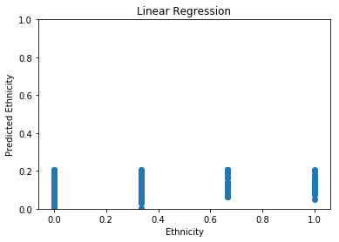
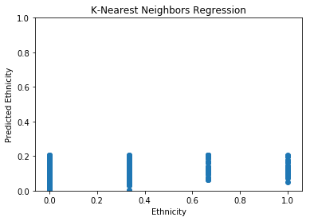
Comparison Between Two Regression Approaches
For regression, I used the Linear and K-Nearest Neighbors algorithms to predict ethnicity based on income, education, and length of essays. The following are respective scatter plots for actual versus prediction:

Slide 16
Comparison Between Two Regression Approaches
Linear regression seems like a more straight-forward approach than K-Nearest Neighbors regression, but the accuracy scores for both training and testing turned out to be much better for K-Nearest Neighbors regression.
The scatter plots for both are very similar.

Slide 17
Comparison Between Two Regression Approaches
The accuracy score for Linear Regression was 0.0258 for training and 0.0183 for testing. I attempted precision_score() and recall_score() only to get an error message when I ran the code.
The accuracy score for K-Nearest Neighbors Regression was 0.951 for training and -0.301 for testing. Again, precision_score() and recall_score() produced an error message that I couldn’t resolve.

Slide 18
Conclusions
A preliminary glance at the data shows that the profiles are of people who make between $25,000 and $100,000 in income and are mostly white and graduated from a 4 year university. Also, education seems to correlate positively with income and with ethnicity, whites and Asians seem to fare better than blacks and Hispanic / Latinos as far as income goes.
With accuracy scores, K-Nearest Neighbors and SVM classification algorithms performed very similarly. True positives were not visibly present in the scatter plot for determining whether or not the word “passionate” appeared in the profiles based on income, education, and ethnicity, perhaps because of the rare occurrence of the word in the essays in the dataset overall. The results were inconclusive.
With accuracy scores, Linear and K-Nearest Neighbors regression algorithms performed differently, with accuracy scores being significantly higher for K-Nearest Neighbors Regression. The scatter plots for both approaches look very similar, but all of the predicted values were between 0.0 and 0.2, indicating the combination of income, education, and essay length were not good features in predicting ethnicity.
The next step would be to collect more data and make certain adjustments for the algorithms like changing values of k for both K-Nearest Neighbors classification and regression methods, as well as experimenting with different kernels for SVM. I only used a subset of the total data to simplify the labels and facilitate my analysis. Perhaps more features can be taken into consideration in the future for predicting the occurrence of a certain word in the essays as well as determining ethnicity. This could have included factors such as religion, astrological sign, and diet.

